Slide 1
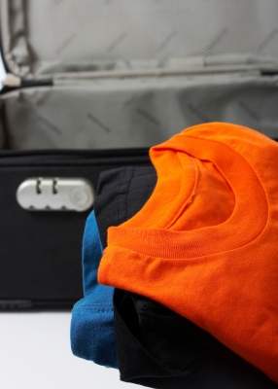
P2 project Bag Packer Program
Made by:
Mette T. Pedersen
Aleksander S. Nilsson
Niels B. Pedersen
Kasper Plejdrup
Christian J. O’Keeffe
Rasmus F. Gadensgaard
Dag T. B. Pedersen

Slide 2
Content of presentation
Problem Analysis
Theory
Design
Development
Testing
Discussion & Conclusion
Process Analysis

Slide 3
Initializing problem
People can’t pack a suitcase properly
Advantage of packing as a family
Forgets saving space for souvenirs
Fees for overweight or oversized luggage
Planes, train and cruises
Many rules regarding allowed items on planes
Notes:
Meetski

Slide 4
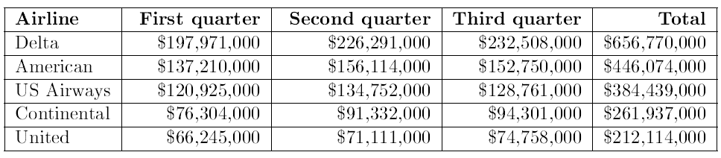
Documentation of problem
People get fees for breaking rules at airports
Notes:
Meetski

Slide 5
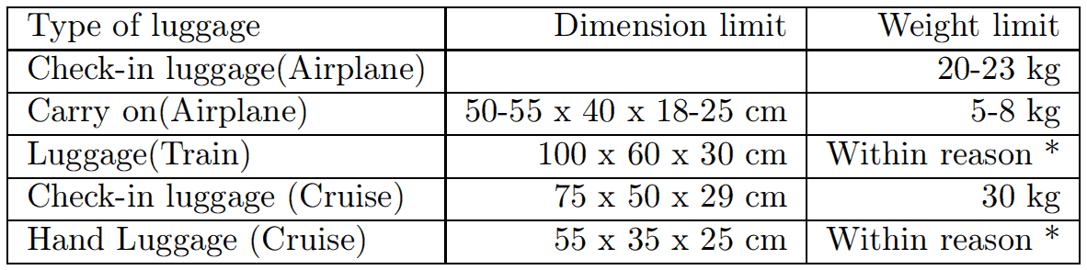
Rules regarding dimensions and weight on different means of transportation
11th of September 2001
5th of October 2006

Slide 6
Solutions on the Market
Existing products:
App - Packing Pro
Online check/tip list
The e-Commerce shipping calculator
The purpose of looking at existing solutions
The products relation to each other
Notes:
Alexandrius

Slide 7
Problem Statement
“How can a program be developed which helps the customer through the process of packing one or more suitcases the most effective way by size and weight?”
Substatements
Notes:
Alexandrius

Slide 8
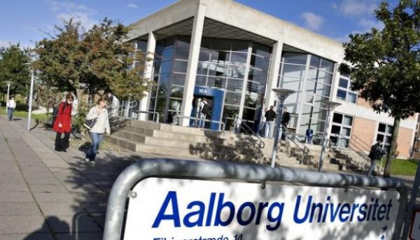
Method
Work by the Aalborg PBL model.
Source criticism
Notes:
Alexandrius

Slide 9


Knapsack/Bin Packing Problem
Knapsack Problem
What is the bin packing problem?
Example of bin packing in 1D
Before packing
After using first fit
Notes:
Niller

Slide 10
Specification Requirements
Targeted Features
Guide the User
Distribute Weight
Distribute Space
On the Road
Baggage Rules
Structure of Packing
Packing list
Save/Load function
Notes:
Niller

Slide 11
Solution suggestions
Application for smartphones
Extension for an existing program
Program for the computer
Choice of solution
Notes:
Niller

Slide 12

Demonstration of program
Notes:
Kappers

Slide 13
Different function description
The packing algorithm
Color assignment function
How the program handles 3D
Function to draw cubes
Notes:
Christian den store

Slide 14
Packing Algorithm
Goal of packing algorithm
Pack by weight and space
Optimization
Using First Fit Decreasing from Bin Packing Theory
Notes:
Christian den store
Distribuere efter vægt så det bliver fordelt optimalt i kufferterne
Checker hele tiden at der bliver lagt hvor der er plads

Slide 15
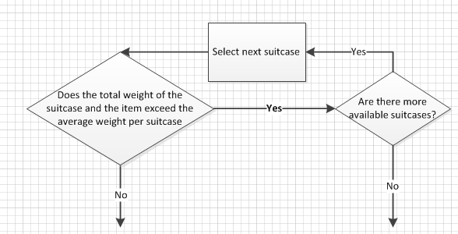
Packing Algorithm

Slide 16
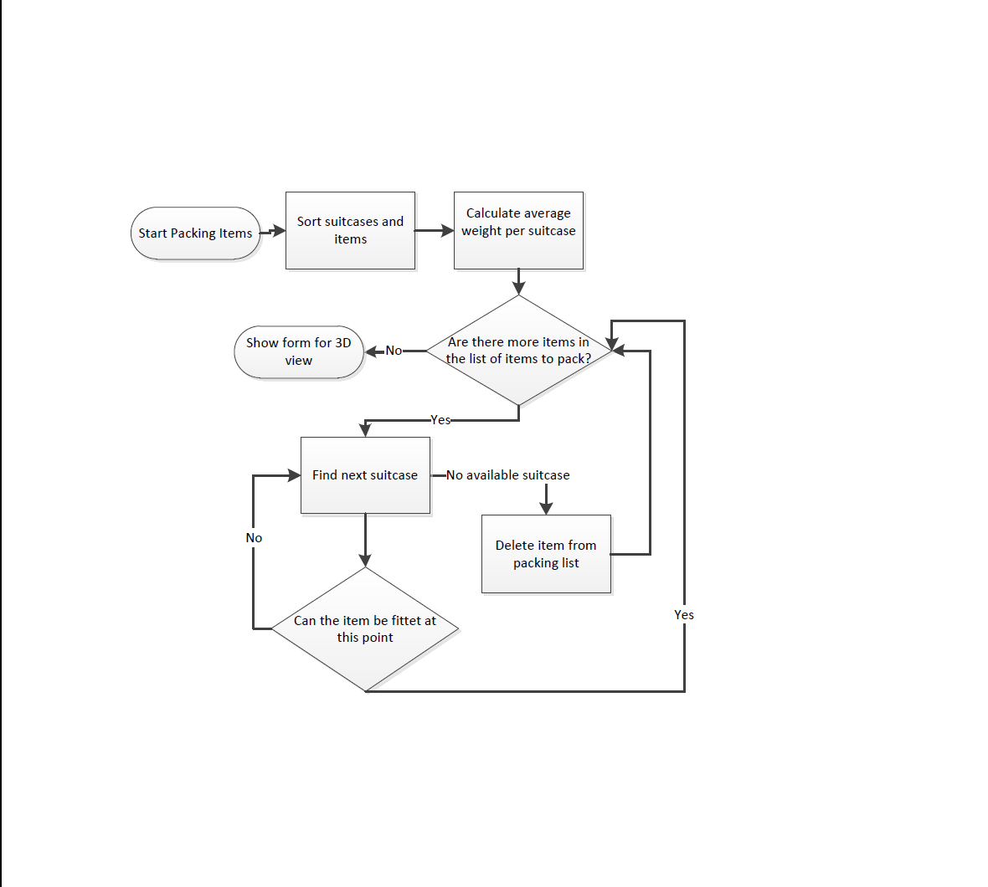
Packing Algorithm

Slide 17
Packing Algorithm
Rotate elements to pack more efficient
Pack them horizontal
Distribute the weight in the suitcases

Slide 18
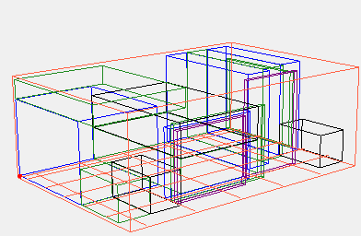
Color Assignment Function
Assigns a color for each item
No item next to each other are given the same color
4 steps:
Add coordinates of each item to a list
Check the list of coordinates for neighbors
Remove duplicate neighbors
Add color numbers to each item
Notes:
Razz

Slide 19
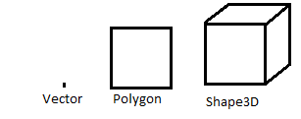
How the program handles 3D
Shape3D class
Consists of 4 Polygons
Polygon class
Consists of 4 Vectors
Vector class
Vectors are generated from the coordinates and dimensions of the items
Notes:
Razz

Slide 20
Testing of the Program
Choice of Survey Method
The First Round of Tests
The Second Round of Tests
Conclusion of Tests
Unit Tests
Notes:
Daine

Slide 21
Discussion
Targeted features
3D viewer
GUI
Notes:
Dagowich

Slide 22
Perspectives
Visual Studio
C#
Interface
Notes:
Dagowich

Slide 23
Conclusion
Packs suitcases correct
Problem statement solved
Notes:
Dagowich

Slide 24
Process Analysis
Project planning
Group Work
Collaboration with Supervisors
Process of Learning
Discussion and Putting Things into Perspective
Conclusion
Notes:
Kappers

